Slide 1
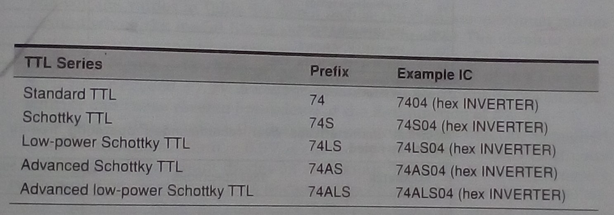
Lecture-13 Various series within the TTL logic family

Slide 2
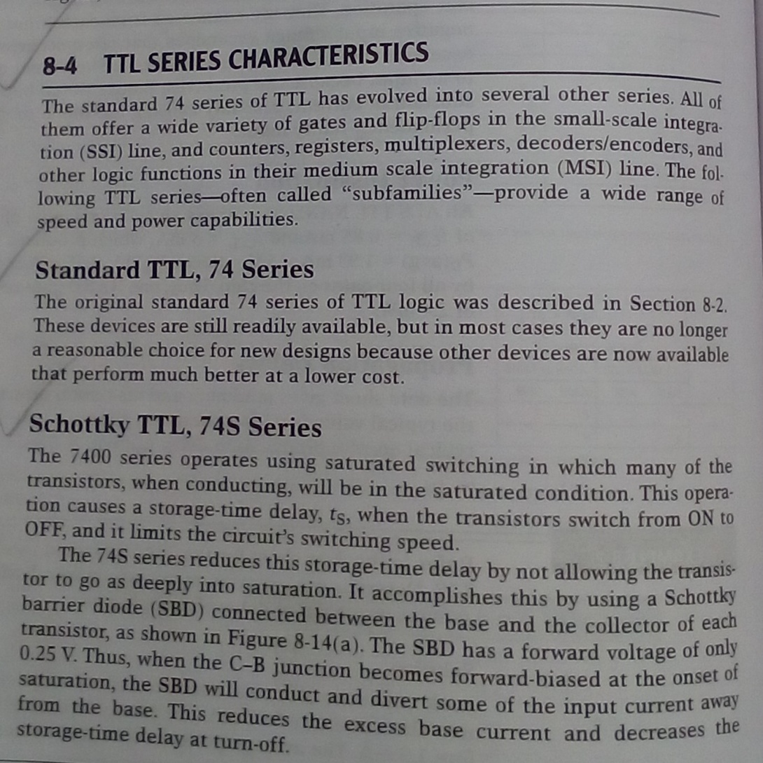
TTL series characteristics

Slide 3
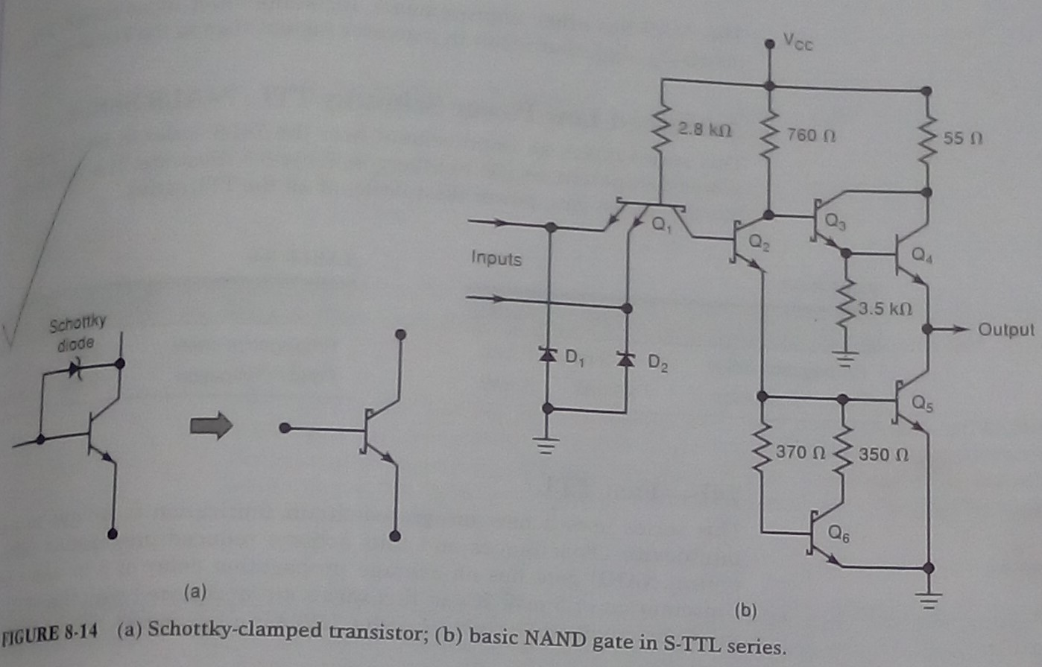
TTL series characteristics

Slide 4
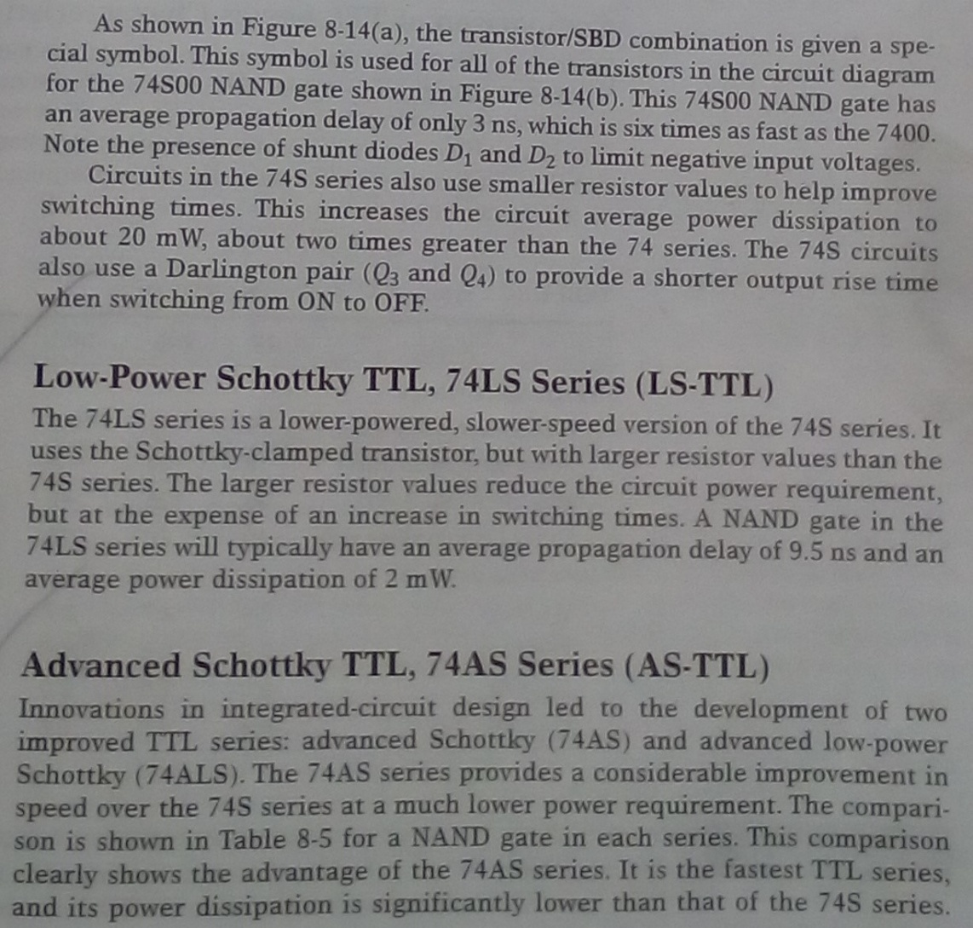
TTL series characteristics

Slide 5
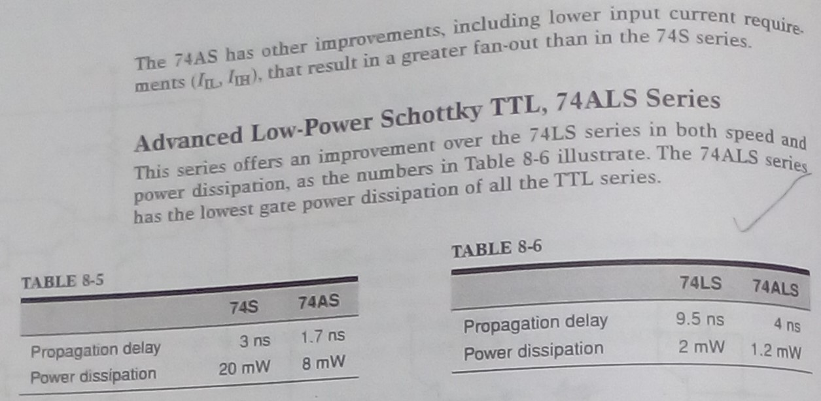
TTL series characteristics

Slide 6
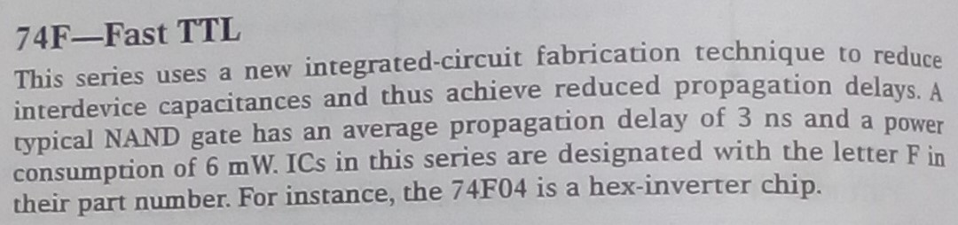
TTL series characteristics

Slide 7
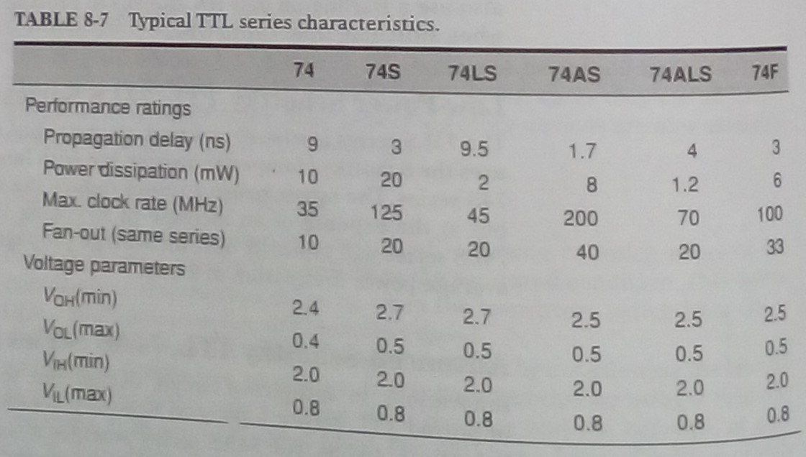
Comparison of TTL series characteristics

